Slide 1
HOLIDAYS HOMEWORK
NAME | AVNIESH KHAJURIA
CLASS | 9TH WANDERING MINDS
ROLL NO. | 07

Slide 2
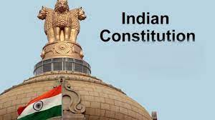

Slide 3

The Constitution of India (Bharatiya Samvidhaan). It is the supreme law of India. The document lays down the framework that demarcates fundamental political code , structure , procedures , powers , and duties of Government institution and sets out fundamental rights , directive principles , and the duties of citizens. It is the longest written constitution of any Country on the Earth .
It was adopted by the Constituent Assembly of India on 26 November 1949 and became effective on 26 January 1950.
The Constitution declares India a sovereign , socialist , secular , and democratic republic assures its citizens justice , equality and liberty , and endeavoures to promote fraternity.

Slide 4
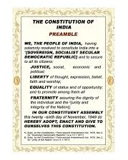
Preamble to the Constitution of India
The Preamble to Constitution of India is guidelines to guide people of the nation, to present the principles of the Constitution, to indicate the source from which the document derives its authority, and meaning.^{[1]} It reflects the hopes and aspirations of the people. The preamble can be referred to as the preface which highlights the entire Constitution. It was adopted on 26 November 1949 by the Constituent Assembly and came into effect on 26 January 1950, celebrated as the Republic day in India. Preamble was made in 1947 but adopted in 1949.

Slide 5




Slide 6
The Indian Constitution Protects The Rights Of Women :
The constitution of India guarantee to all Indian women equality (Article14) , no discrimination by the State (Article 15(1)) , equality of opportunity (Article 16) , equal pay for equal work (Article 39d) and Article 42 .
The status of women in India has been subject to many changes over the span of recorded Indian history . Their position in society deteriorated early in India’s ancient period , especially in the Indo – Aryan Speaking regions , and their subordination continued to be reified well into India’s early modern period .
Women in India now participate fully in areas such as education , sports , politics , media , art , and culture , service sectors , science and technology, etc. Indira Gandhi , who served as Prime Minister of India for an aggregate period of fifteen years , is the world’s longest serving female Prime Minister.

Slide 7
The areas that violate the rights of women in India have been stated as follows :
Domestic Violence
Female Foeticide
Sexual Harassment
Rape
Sati
Discrimination For Education
Female Infanticide
Empowerment Of Women
Empowerment is a complex issue , with varying interpretation in social , economic , cultural , and political frameworks. With empowerment of women , they began to acquire understanding of number of areas , participation in the decision making process ; domestic work should be carried by both males and females and not just females by themselves ; women should take control of the reproductive and decide on the size of the family ; women should be allowed to spend the income , she has earned , according to her own needs and desire.

Slide 8
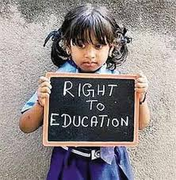
The Indian Constitution Protects The Rights Of Children :
Children’s rights are human rights that are accustomed explicitly to the children needs , wants and overall well being. They take into account their fragility , specificities and age – appropriate requirements. Children’s right aim to take into account the necessity of the development of a child .

Slide 9

Constitution Guarantee that are meant specifically to children :
Right to free and compulsory elementary education for all children in the 6-14 year age group (Article 21 A)
Right to be protected from being abused and forced by economic necessity to enter occupation unsuited to their age or strength (Article 39 E)
Right to be protected from any hazardous employment till the age of 14 years (Article 24)
Right to equal opportunities and facilities to develop in a health manner and in condition of freedom and dignity and guarantee protection of childhood and youth against exploitation and against moral and material abandonment (Article 39 F)
Right to early childhood care and education to all children until they complete the age of six years (Article 45)

Slide 10



Slide 11
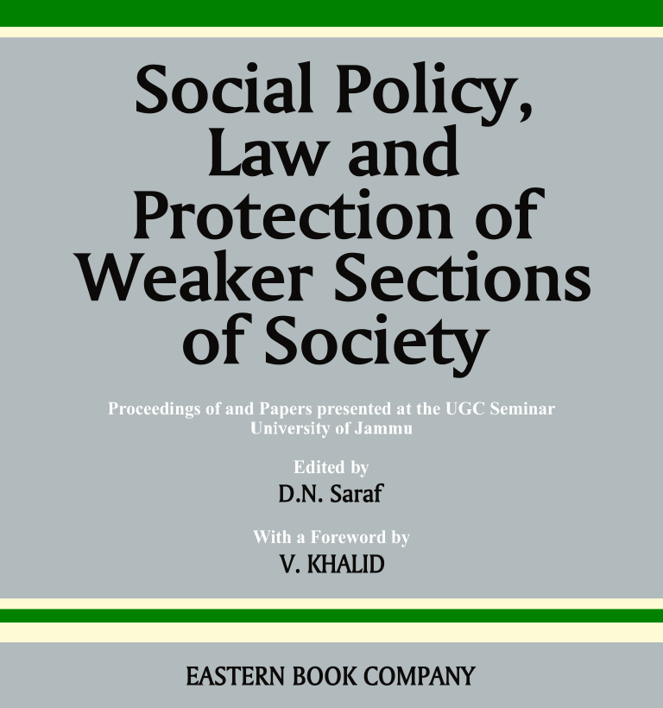
Constitution Provisions for Protection of Weaker Section:
Articles 14 , 15 , 28 , 29 and 30 of the constitution have protected the interest of the minority communities in India.
Article 14 provides equality before law and equal protection against discrimination irrespective of religion or caste.
Article 28 safeguard the minority from enforceable religious teachings (such as dress code for specific prayer and all) in all government funded educational institutions.
Article 29 provides protection of language, script, culture, and conserve the same.
The Constitution has declared India to be a secular country in which people of each and every religion has the right to profess, practice and propagate their own religion.

Slide 12
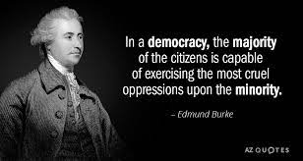
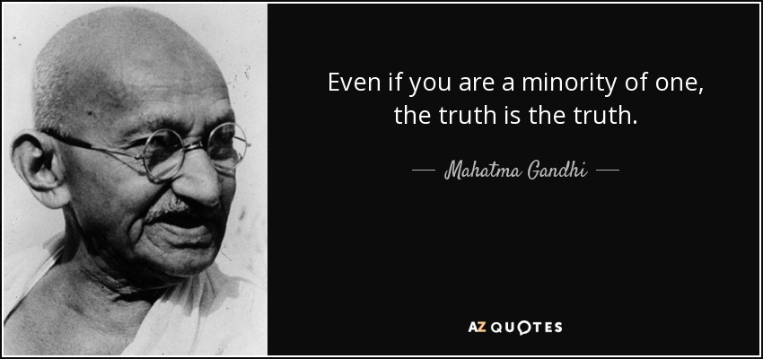
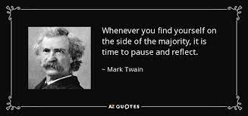
Government of India has formulated the “Prime Minister’s New 15-Point Program for the Welfare of Minorities”. An important objective of the Program is to ensure that an appropriate percentage of the priority sector lending is targeted for the minority communities and that the benefits of various government sponsored schemes reach the under-privileged, which includes the disadvantaged sections of the minority communities. The Program is being implemented by the Central Ministries/Departments concerned through State Governments/Union Territories and envisages location of certain proportion of development projects in minority concentration districts.

Slide 13
THANK YOU

